Slide 1
Authentication Using OpenID Connect and OAuth2
@ATLCODECAMP
HTTPS://ATLANTACODECAMP.COM/2016

Slide 2

Mark A. Wilson
www.developerinfra.com
@DeveloperInfra
Software craftsman, consultant and agile .NET/JavaScript web developer. User group leader and event planner. Loving husband, dog foster, and Disney aficionado.
Notes:
17 notable references in Wikipedia.

Slide 3
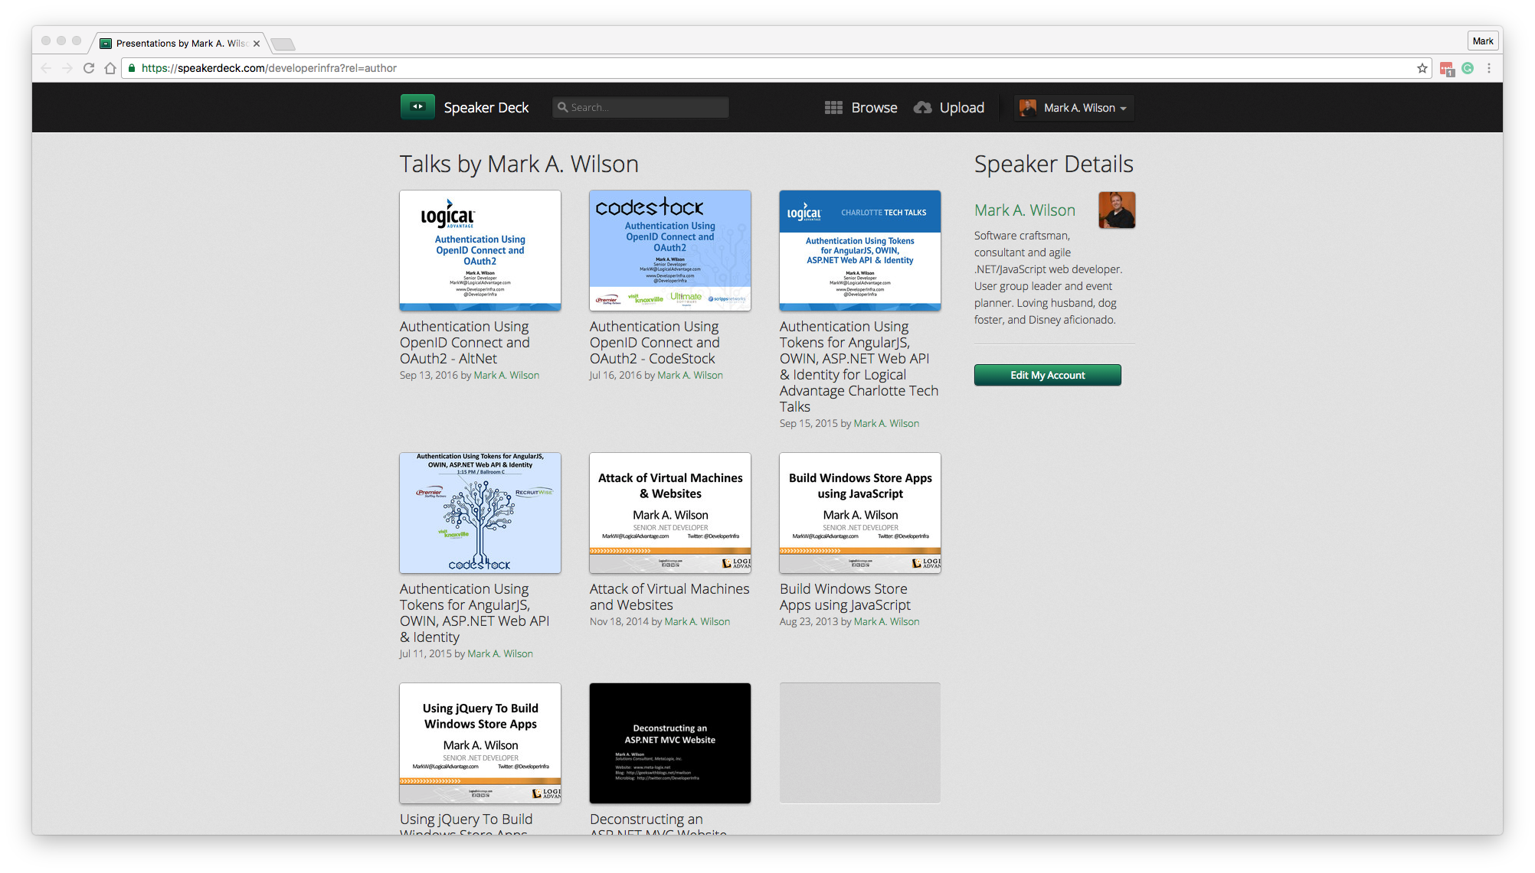
Slide Deck
https://speakerdeck.com/developerinfra

Slide 4
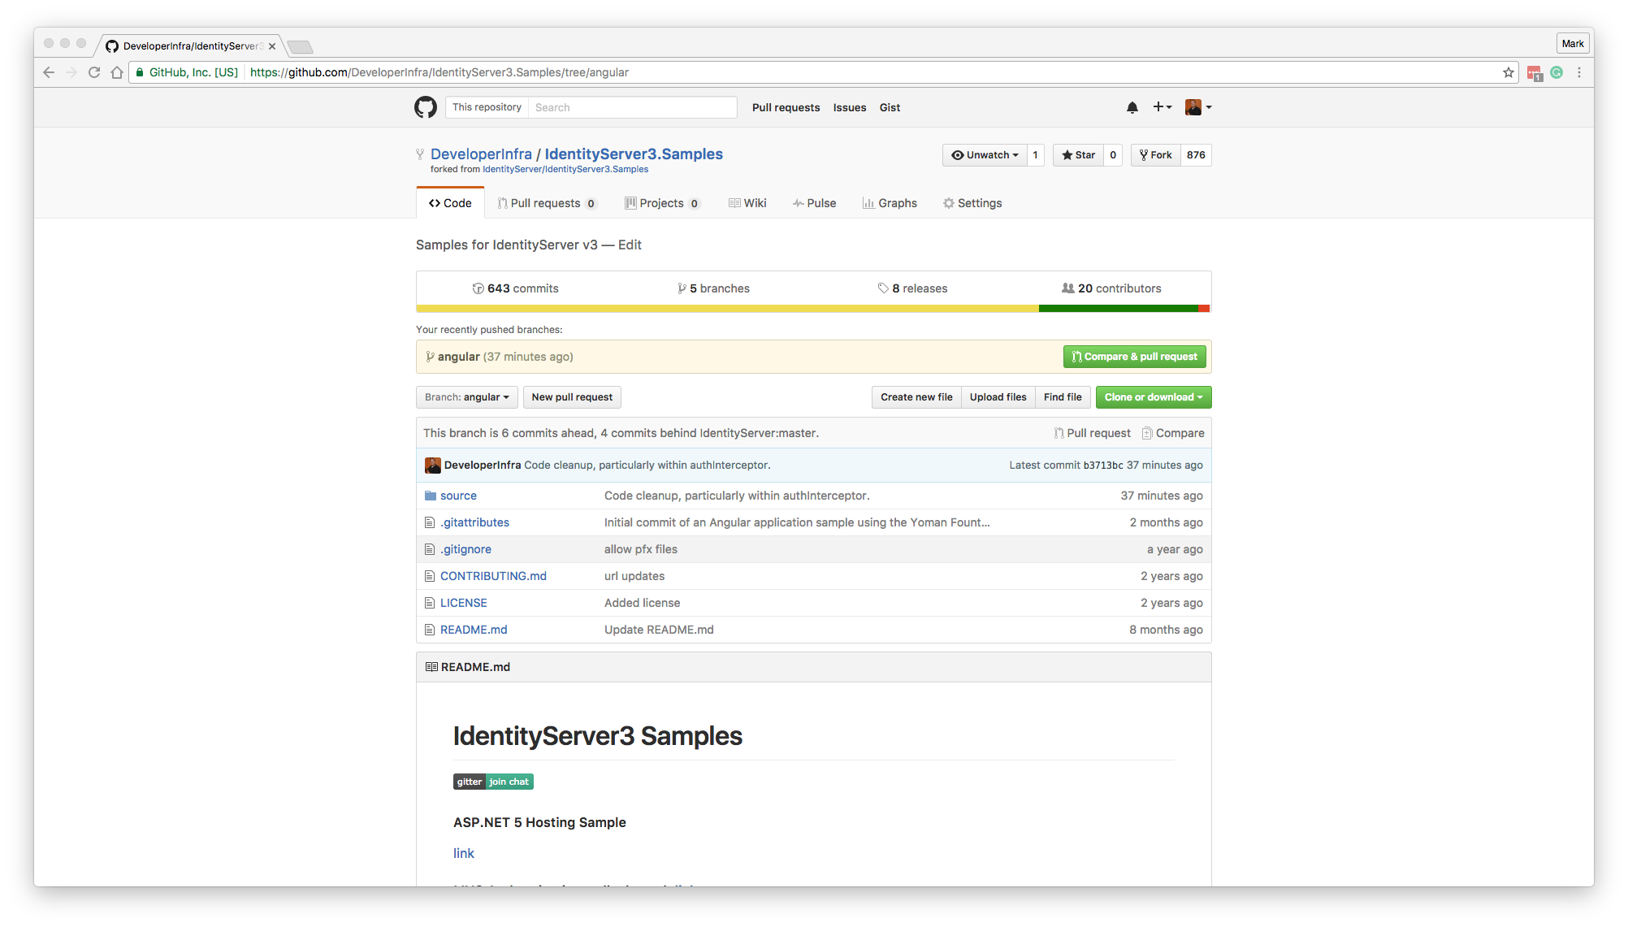
Source Code
https://github.com/DeveloperInfra/IdentityServer3.Samples/tree/angular

Slide 5


Logical Advantage
www.logicaladvantage.com
Our mission is to partner with our clients to provide strategies and solutions that maximize the ROI of Enterprise Asset Intelligence and Human Capital Development.
Notes:
Business cards up front.

Slide 6




Platinum Sponsors

Slide 7







Gold Sponsors

Slide 8





Silver Sponsors
SWAG Sponsors

Slide 9
Surveys and Prizes
Please complete the session and event surveys!
1 ticket per session survey
1 ticket for the event survey
1 ticket for completing the booth game
Drawing for prizes begins at 5pm in Q202

Slide 10
Authentication Using Tokens for AngularJS, OWIN, ASP.NET Web API & Identity

Slide 11
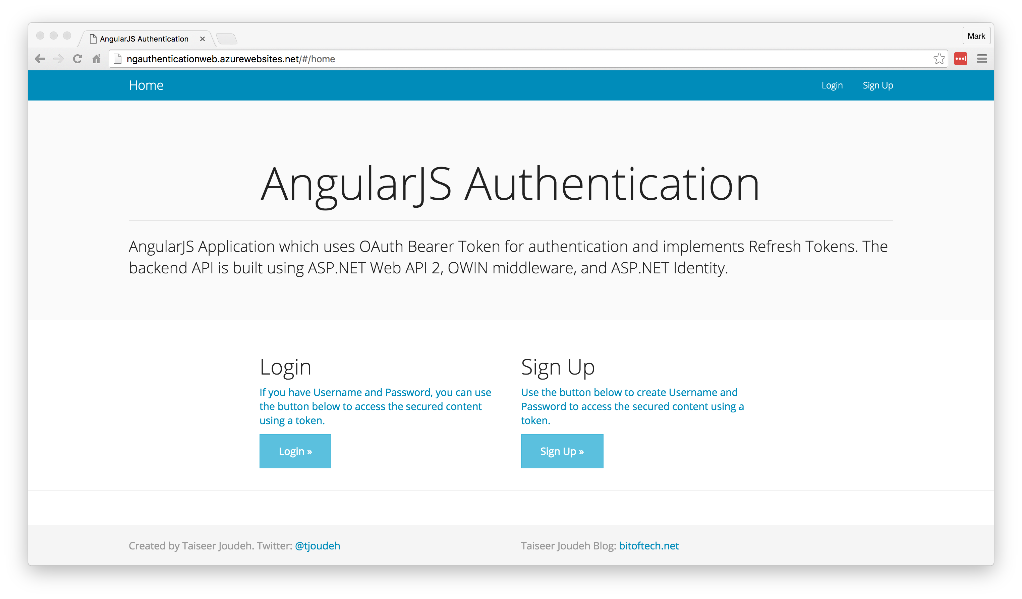
AngularJS Authentication Demo
http://bitoftech.net/2014/06/01/token-based-authentication-asp-net-web-api-2-owin-asp-net-identity/

Slide 12
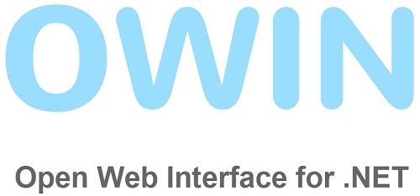
Open Web Interface for .NET
A specification, not a framework
A standard for an interface between .NET web applications and web servers
Decouple the application from the [IIS] server
Encourage development of simple and lightweight modules
Project Katana is OWIN implementations for Microsoft servers and frameworks
https://en.wikipedia.org/wiki/Open_Web_Interface_for_.NET

Slide 13
Project Katana
A set of OWIN components built by Microsoft
Enables ASP.NET applications to be flexible, portable, lightweight, and provide better performance
Host – An executable process
Server – Opens network sockets
Middleware – Pipeline of OWIN components
Application – Your code
Application
Middleware
Server
Host
http://www.asp.net/aspnet/overview/owin-and-katana/an-overview-of-project-katana

Slide 14

OAuth 2.0
Authorization framework
Began in November 2006 when Blaine Cook was developing the Twitter OpenID implementation
OAuth 1.0 – April 2010
OAuth 2.0 – October 2012
Allows access tokens be issued to third-party clients/websites
Not without its critics and controversy
https://en.wikipedia.org/wiki/OAuth

Slide 15
OAuth 2.0
Does not support signature, encryption, channel binding, or client verification.
Relies completely on Transport Layer Security (TLS) / Secure Sockets Layer (SSL).
“Covert Redirect” involving the redirect_uri.
Phishing site attacks.
Eran Hammer resigned as lead author in July 2012.
“OAuth 2.0 is not an authentication protocol.”
https://en.wikipedia.org/wiki/OAuth

Slide 16
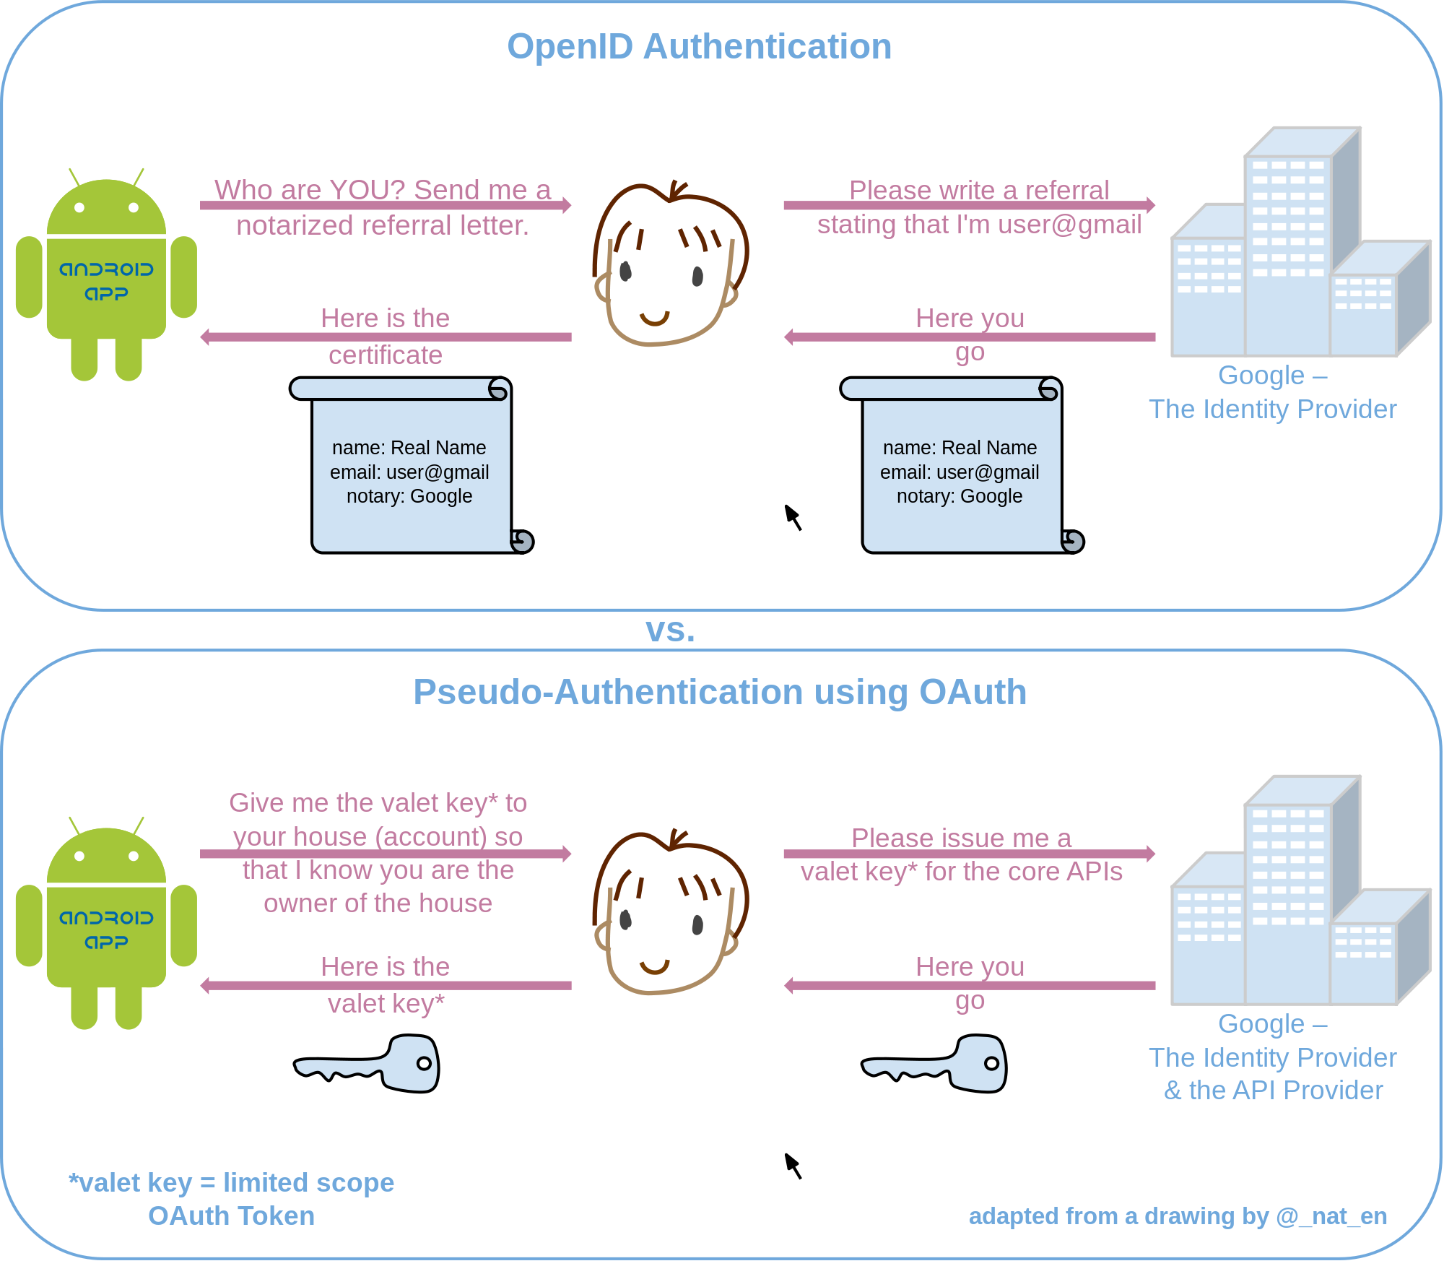
Pseudo-Authentication using OAuth
https://en.wikipedia.org/wiki/OAuth

Slide 17

Project Katana
”vNext is the successor to Katana (which is why they look so similar). Katana was the beginning of the break away from System.Web and to more modular components for the web stack.”
– David Fowler ASP.NET Core Architect
http://forums.asp.net/t/2004299.aspx?Katana%20VS%20vNext

Slide 18
Is it worth it?
Pros
Cons
Authentication & authorization abstracted into a “component” using standard protocol (OAuth2)
Eliminated the cookie and Cross-Site Request Forgery (CSRF) problems for SPAs
Encrypted and signed tokens (using shared machine key)
SSL by default
Resource owner flow very easy.
Exponentially complex
Adding refresh tokens required implementing persistence
Implicit flow (native or JS apps) lacked login/consent view engine
Lacking in validation
The ASP.NET team decided to discontinue Project Katana to focus on consuming tokens
“Note: This outline should not be intended to be used for creating a secure production app.”
https://leastprivilege.com/2014/03/24/the-web-api-v2-oauth2-authorization-server-middlewareis-it-worth-it/

Slide 19
Modern Applications

Slide 20
This happened…
No SOAP
No SAML
No WS*
No Windows
No Enterprise

Slide 21
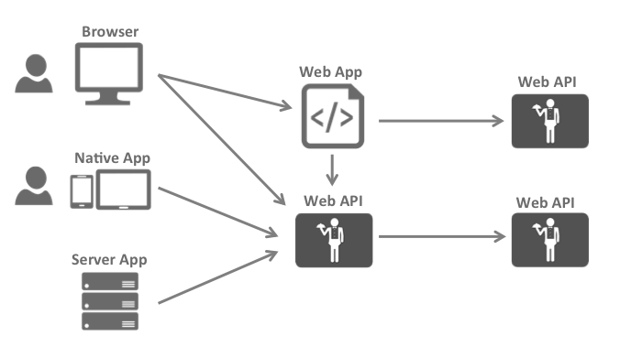
The Big Picture
https://identityserver.github.io/Documentation/docsv2/overview/bigPicture.html

Slide 22
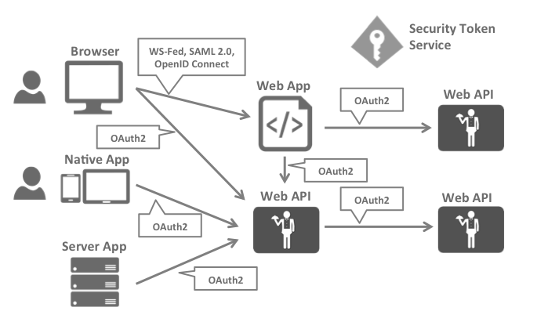
Security Protocols
https://identityserver.github.io/Documentation/docsv2/overview/bigPicture.html

Slide 23
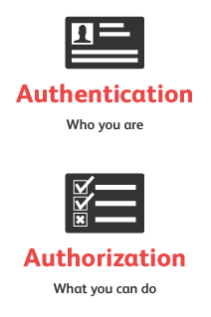
Security Concerns
Authentication
API Access
Identity of the current user
Application identity and/or delegating the user’s identity
https://identityserver.github.io/Documentation/docsv2/overview/bigPicture.html

Slide 24

Security Assertion Markup Language
Most popular & widely deployed
SAML 1.0 – November 2002
SAML 1.1 – September 2003
SAML 2.0 – March 2005
Browser single sign-on (SSO)
Problematic beyond intranet
XML-based
“Enterprisey” and “not trivial”
https://en.wikipedia.org/wiki/Security_Assertion_Markup_Language

Slide 25
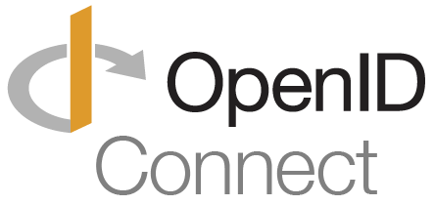
OpenID Connect
Newest but generally considered to be the future
OpenID – May 2005
OpenID 2.0 – December 2007
OIDC [3.0] – February 2014
Designed to be more usable by native and mobile applications
RESTful HTTP API using JSON
Authentication layer on top of the OAuth 2.0 authorization framework
Uses the JSON Web Token (JWT) and JSON Object Signing and Encryption (JOSE) specs
https://en.wikipedia.org/wiki/OpenID

Slide 26
https://en.wikipedia.org/wiki/OAuth

Slide 27
Better Together
https://identityserver.github.io/Documentation/docsv2/overview/bigPicture.html

Slide 28
Authentication Using OpenID Connect and OAuth2

Slide 29
OpenID Connect
“OpenID Connect 1.0 is a simple identity layer on top of the OAuth 2.0 protocol.”
Defines identity tokens
Defines standard token type
Defines standard cryptography
Defines validation procedures
Defines flows for browser, native, and server-based apps
Combines authentication with short/long-lived delegated API access
http://openid.net/connect/

Slide 30
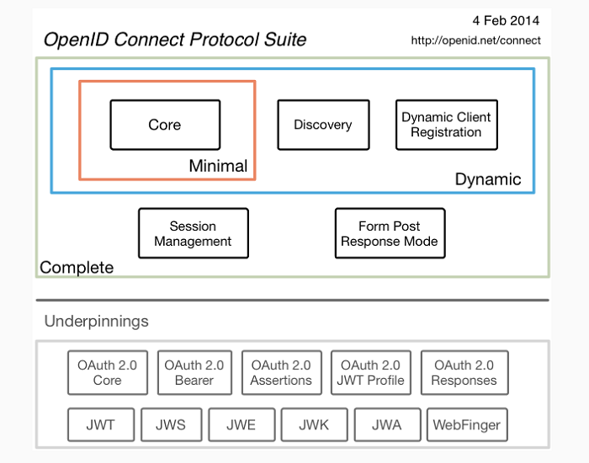
OpenID Connect
http://openid.net/connect/

Slide 31



OpenID Connect
Authorize Endpoint
Token Endpoint
UserInfo Endpoint

Slide 32

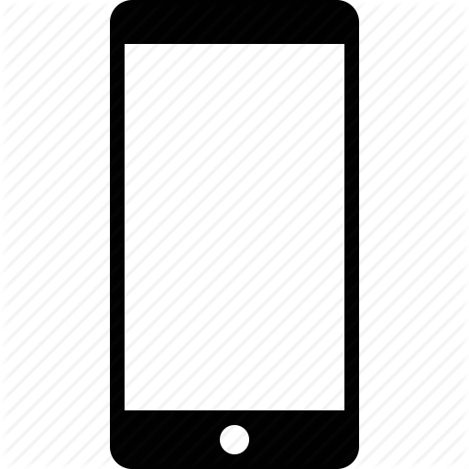

Flows
Client Credentials Flow
(Server-to-Server/IoT)
Implicit Flow
(Browser-based)
Hybrid Flow
(Native/Mobile)

Slide 33
Implicit Flow
GET /authorize
?client_id=app1
&redirect_uri=https://app.com/cb
&response_type=id_token
&response_mode=form_post
&nonce=a1b…x9z
&scope=openid email

Slide 34
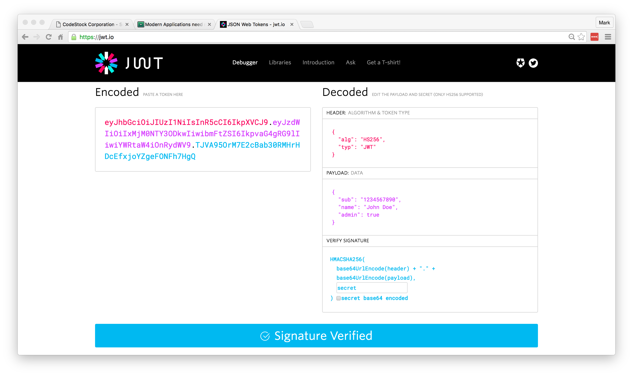
Identity Token
https://jwt.io/

Slide 35
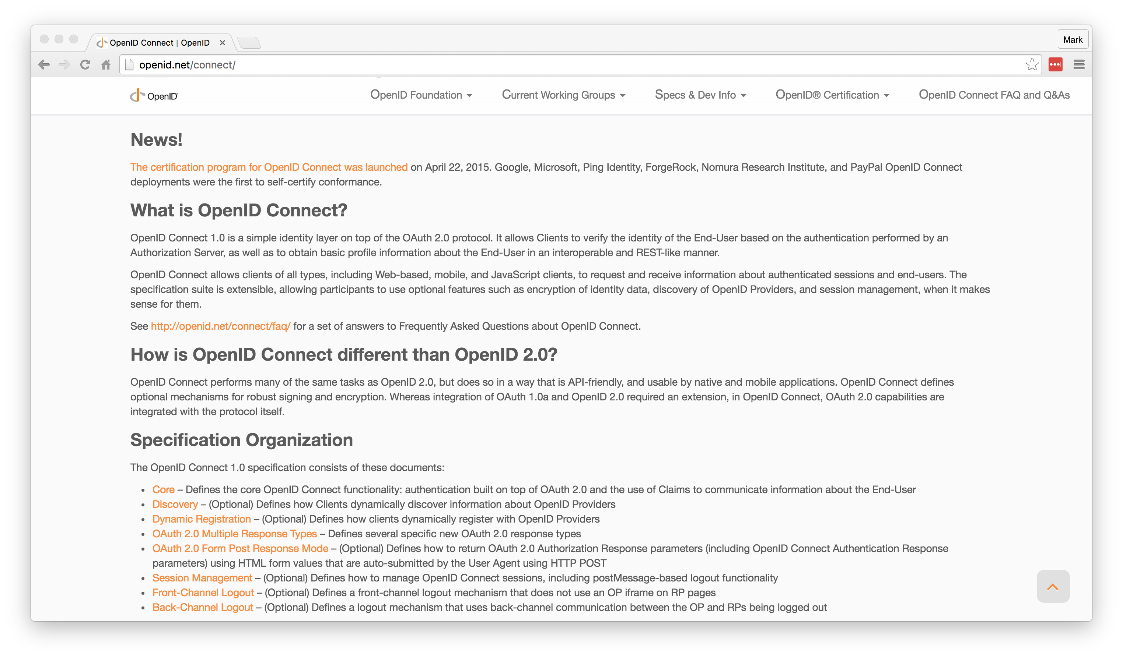
Getting Started
http://openid.net/connect/

Slide 36
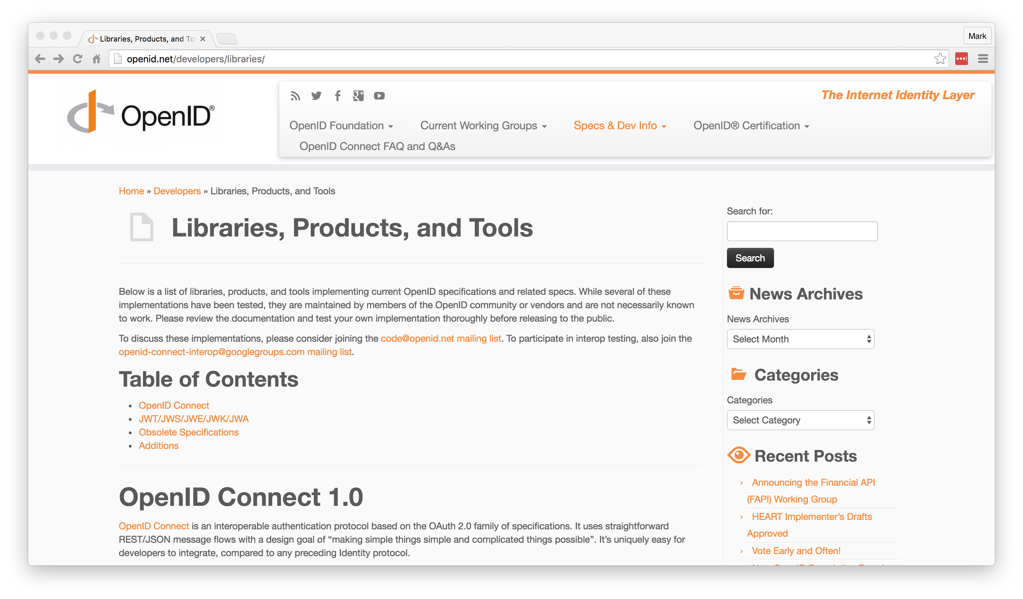
Getting Started
http://openid.net/developers/libraries/

Slide 37
IdentityServer

Slide 38
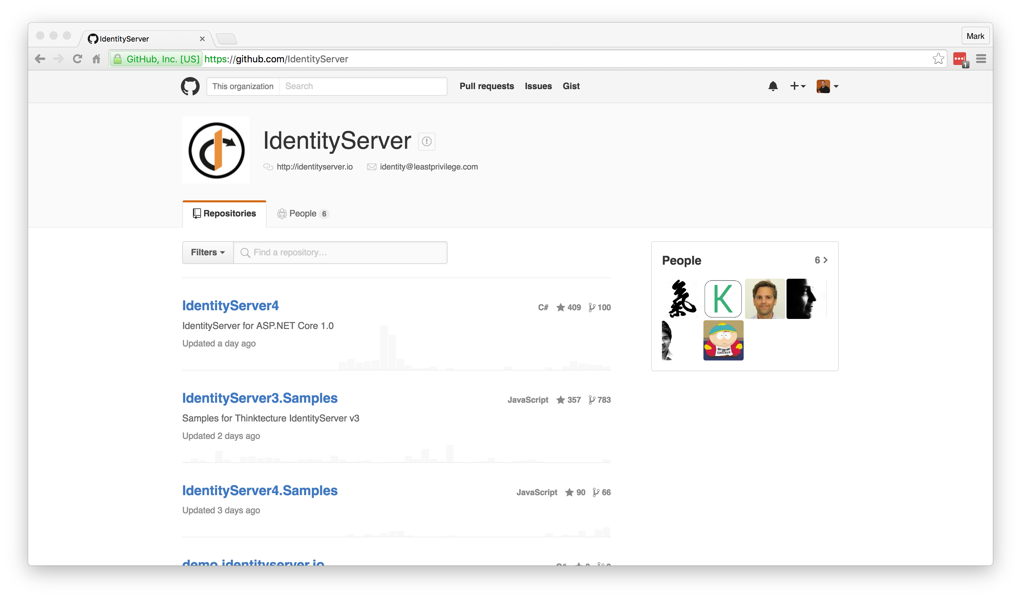
Getting Started
https://github.com/IdentityServer

Slide 39
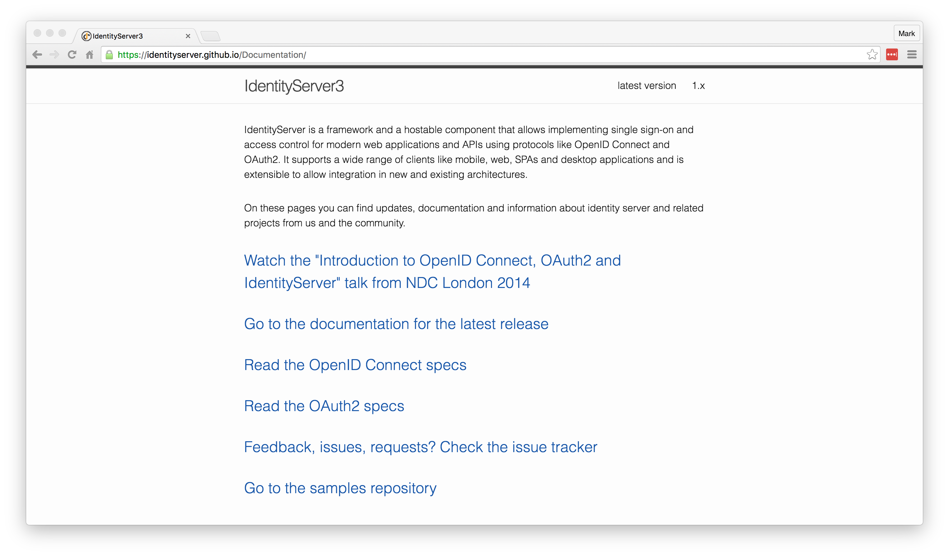
Getting Started
https://identityserver.github.io/Documentation/

Slide 40
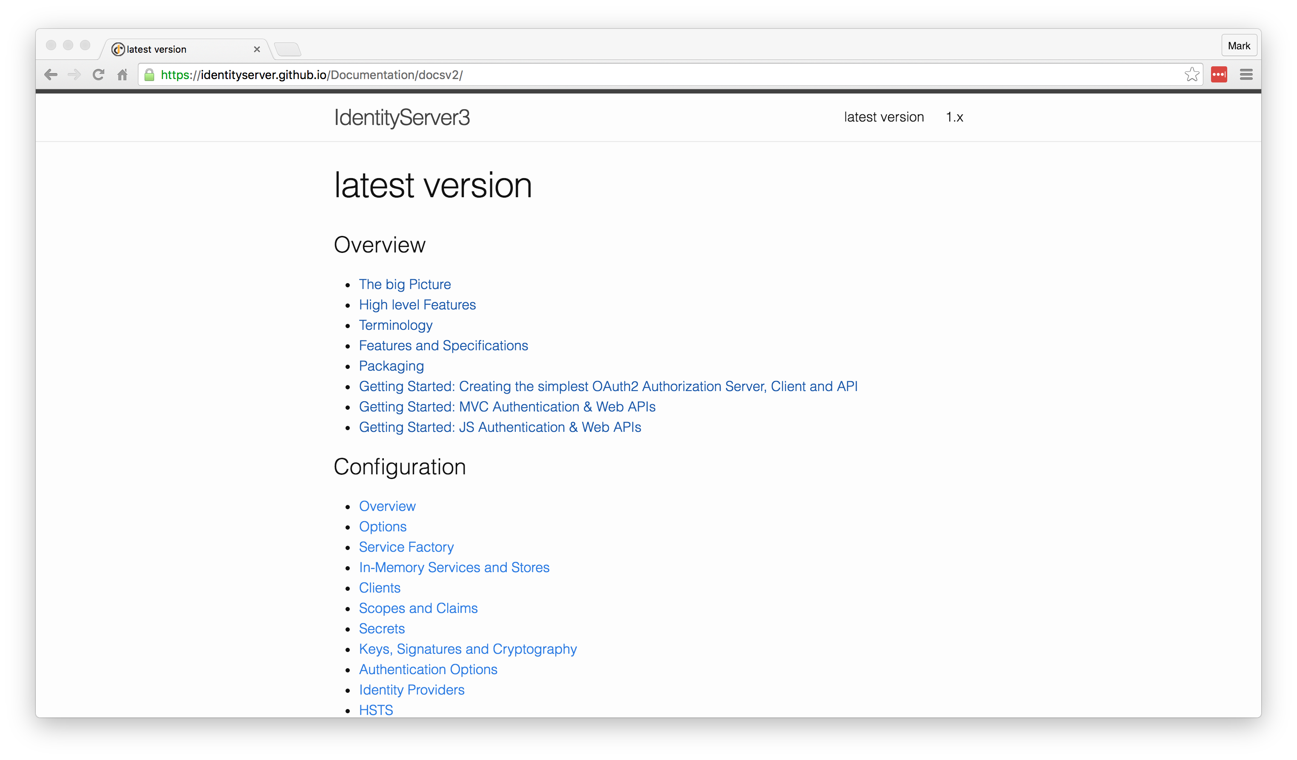
Getting Started
https://identityserver.github.io/Documentation/docsv2/

Slide 41
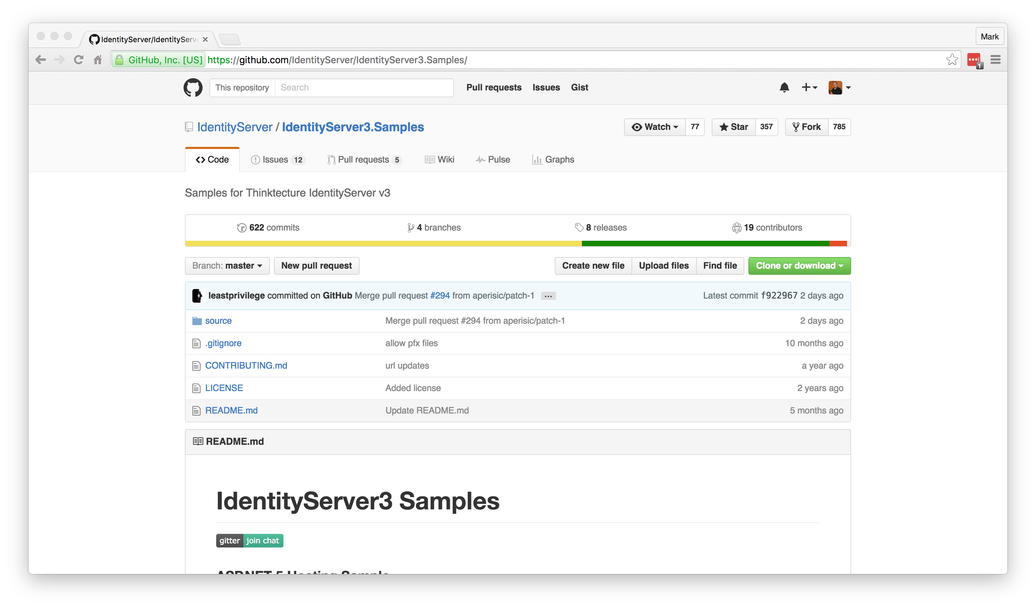
Getting Started
https://github.com/IdentityServer/IdentityServer3.Samples/

Slide 42


IdentityServer
DEMO

Slide 43
Resources
OpenID Connect: http://openid.net/connect/
OpenID Connect Libraries: http://openid.net/developers/libraries/
IdentityServer: https://github.com/IdentityServer
IdentityServer Samples: https://github.com/IdentityServer/IdentityServer3.Samples/
OAuth for ASP.NET: http://www.oauthforaspnet.com/
JSON Web Tokens: https://jwt.io/
Notes:
HTTPS: Use it!
Forms Auth: Happy path, easiest to setup. Transmits in clear text.
3rd-Party Logins: All implemented differently. Takes time.
Custom Grant Type: Forms vs. 3rd-Party take separate paths.
Entity Framework: Everything uses it by default.
Production Ready: Maybe not public-facing. Very little validation/checking.

Slide 44

Authentication Using OpenID Connect and OAuth2
Mark A. Wilson Senior Developer MarkW@LogicalAdvantage.com
www.DeveloperInfra.com @DeveloperInfra

